Slide 1
Numerical Control

Slide 2
Numerical Control
a form of programmable automation in which the process is controlled by numbers, letters, and symbols
a program of instructions designed for a particular work-part or job
When the job changes, the program of instructions is changed.
This capability to change the program for each new job is what gives NC its flexibility

Slide 3
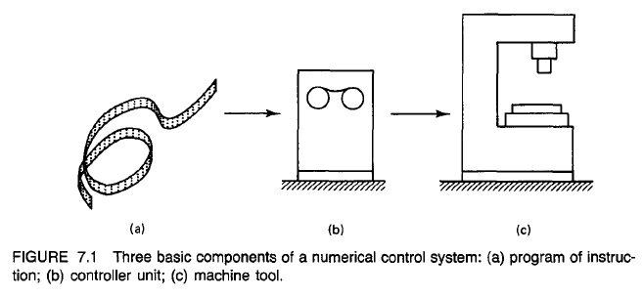
BASIC COMPONENTS OF AN NC SYSTEM
1. Program of instructions
2. Controller unit, also called a machine control unit (MCU)
3. Machine tool or other controlled process

Slide 4
1. Program of instructions
The program of instructions is the detailed step-by-step set of directions which tell the machine tool what to do.
It is coded in numerical or symbolic form on some type of input medium that can be interpreted by the controller unit.
The part program is converted into a sequence of machine tool actions by means of the input medium, which contains the program the controller unit, which interprets the input medium.
The controller unit and the input medium must be compatible - the input medium uses coded symbols which represent the part program, and the controller unit must be capable of reading those symbols

Slide 5
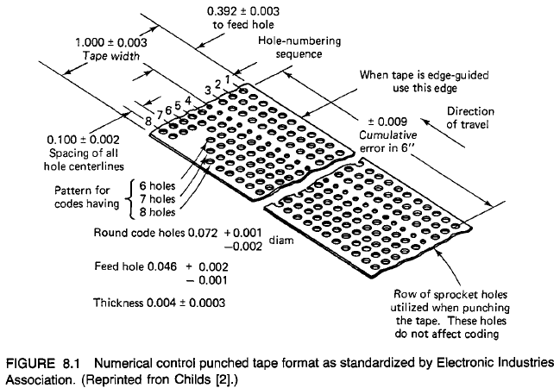
PUNCHED TAPE IN NC
There are eight regular columns of holes running in the lengthwise direction of the tape.
There is also a ninth column of holes between the third and fourth regular columns. However, these are smaller and are used as sprocket holes for feeding the tape.
The coding of the tape is provided by either the presence or absence of a hole in the various positions.
Because there are two possible conditions for each position—either the presence or absence of a hole—this coding system is called the binary code.
The NC tape coding system is used to code not only numbers, but also alphabetical letters and other symbols.
Eight columns provide more than enough binary digits to define any of the required symbols.
A character is a combination of bits, which represents a letter, number, or other symbol.
A word is a collection of characters used to form part of an instruction.

Slide 6
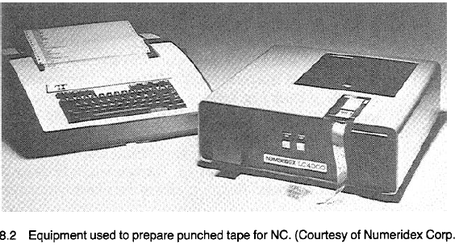
Preparing the punched tape
There are two basic methods of preparing the punched tape.
The first method is associated with manual part programming and involves the use of a typewriterlike device.
After the last instruction has been read into the controller, the tape is rewound back to the start of the program to be ready for the next work-part.
The second method is used with computer-assisted part programming - by this approach, the tape is prepared directly by the computer using a device called a tape punch.
During production on a conventional NC machine, the tape is fed through the tape reader once for each workpiece.
It is advanced through the tape reader one instruction at a time.
While the machine tool is performing one instruction, the next instruction is being read into the controller unit's data buffer.
This makes the operation of the NC system more efficient.

Slide 7
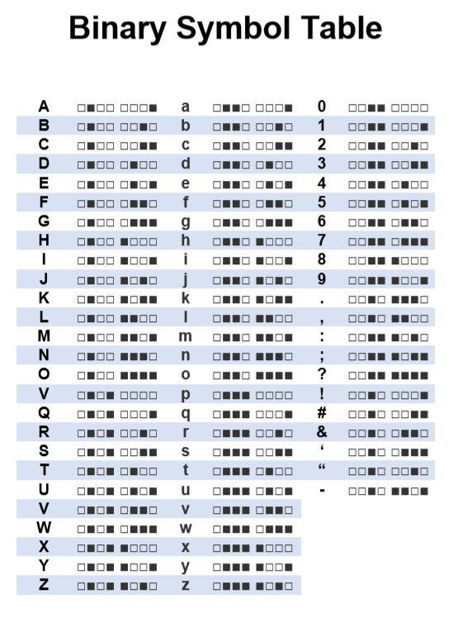
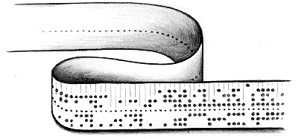
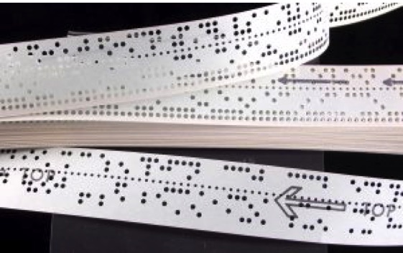

Slide 8
2. Controller unit
The second basic component of the NC system is the controller unit.
This consists of the electronics and hardware that read and interpret the program of instructions and convert it into mechanical actions of the machine tool.
The typical elements of a conventional NC controller unit include
The tape reader
a data buffer
Signal output channels to the machine tool
Feedback channels from the machine tool
The sequence controls to coordinate the overall operation of the foregoing elements.

Slide 9
The tape reader is an electromechanical device for winding and reading the punched tape containing the program of instructions.
The data contained on the tape are read into the data buffer
The purpose of this device is to store the input instructions in logical blocks of information.
A block of information usually represents one complete step in the sequence of processing elements.
For example, one block may be the data required to move the machine table to a certain position and drill a hole at that location.
The signal output channels are connected to the servomotors and other controls in the machine tool.
Through these channels, the instructions are sent to the machine tool from the controller unit
To make certain that the instructions have been properly executed by the machine, feedback data are sent back to the controller via the feedback channels.
The most important function of this return loop is to assure that the table and work-part have been properly located with respect to the tool.
Sequence controls coordinate the activities of the other elements of the controller unit.
The tape reader is actuated to read data into the buffer from the tape, signals are sent to and from the machine tool, and so on. - These types of operations must be synchronized and this is the function of the sequence controls.

Slide 10
3. Machine tool
The third basic component of an NC system is the machine tool or other controlled process.
It is capable of performing a variety of different operations: drilling, tapping, reaming, milling, and boring
A variety of machining operations means that a variety of cutting tools are required.
The tools are kept in a tool drum or other holding device. When the tape calls a particular tool, the drum rotates to position the tool for insertion into the spindle.
The automatic tool changer then grasps the tool and places it into the spindle chuck.

Slide 11
NC Procedure
To utilize numerical control in manufacturing, the following steps must be accomplished.
Process planning.
The engineering drawing of the work-part must be interpreted in terms of the manufacturing processes to be used.
This step is referred to as process planning and it is concerned with the preparation of a route sheet.
The route sheet is a listing of the sequence of operations which must be performed on the work-part.
It is called a route sheet because it also lists the machines through which the part must be routed in order to accomplish the sequence of operations
2. Part programming
Manual part programming
Computer-assisted part programming
3. Tape preparation.
A punched tape is prepared from the part programmer’s NC process plan
4. Tape verification
5. Production

Slide 12
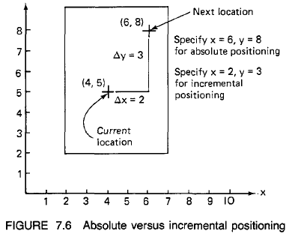
Absolute positioning and incremental positioning

Slide 13
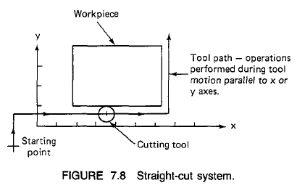
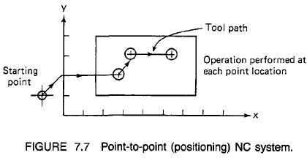
NC MOTION CONTROL SYSTEMS
In order to accomplish the machining process, the cutting tool and workpiece must be moved relative to each other
There are three basic types of motion control systems:
Point-to-point NC:
In PTP, the objective of the machine tool control system is to move the cutting tool to a predefined location
The speed or path by which this movement is accomplished is not important
Once the tool reaches the desired location, the machining operation is performed at that position.
NC drill is a good example of PTP systems
Straight-cut NC
Straight-cut control systems are capable of moving the cutting tool
parallel to one of the major axes at a controlled rate suitable for machining.
Appropriate for performing milling operations
it is not possible to combine movements in more than a single axis direction. Therefore, angular cuts on the workpiece would not be possible.
An example of a-straight-cut operation is shown in Figure

Slide 14
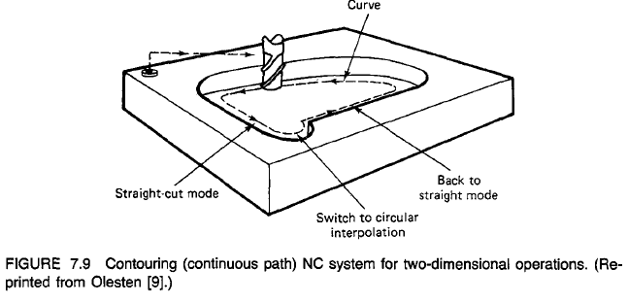
NC MOTION CONTROL SYSTEMS
Contouring NC:
Contouring is the most complex, the most flexible, and the most expensive type of tool control
It is capable of performing both PTP and straight-cut operations
In addition, simultaneous control of more than one axis movement of the machine tool
The path of the cutter is continuously controlled to generate the desired geometry of the workpiece
For this reason, contouring systems are also called continuous-path NC systems.
Straight or plane surfaces at any orientation, circular paths, conical shapes are possible under contouring control

Slide 15
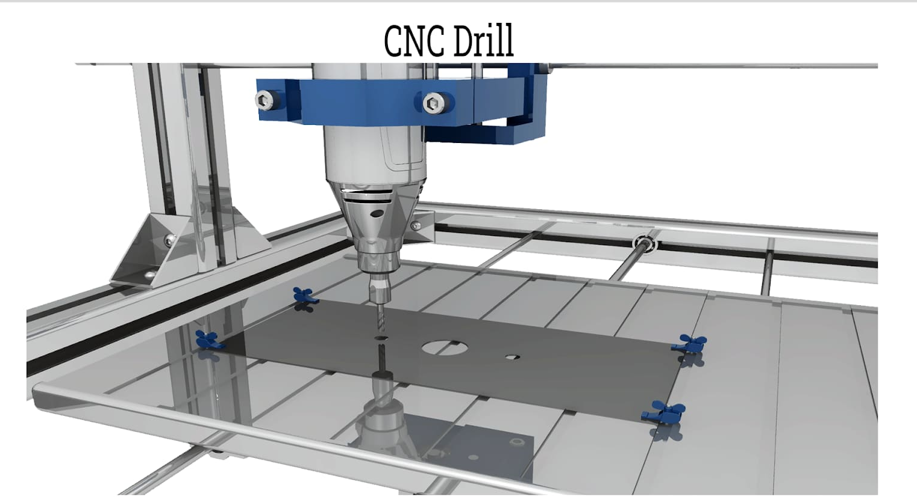
Advantages of NC Disadvantages of NC
Reduced nonproductive time
2. Reduced fixturing
3. Reduced manufacturing lead time
4. Greater manufacturing flexibility
5. Improved quality control
6. Reduced inventory
7. Reduced floor space requirement
Higher investment
2. Higher maintenance cost
3. Finding and/or training NC personnel

Slide 16
Computer Controls in NC
The computer is being used to refine and improve the NC part programming procedure through interactive graphics and voice programming

Slide 17
PROBLEMS WITH CONVENTIONAL NC
1. Part programming mistakes.
2. Nonoptimal speeds and feeds - In conventional numerical control, the control system does not provide the opportunity to make changes in speeds and feeds during the cutting process
3. Punched tape - Paper tape is especially fragile, and its susceptibility to wear and tear causes unreliable NC component for repeated use in the shop
4. Tape reader - least reliable hardware component of the machine
5. Controller. The conventional NC controller unit is hard-wired, control features cannot be easily altered to incorporate improvements into the unit - Use of a computer as the control device would provide the flexibility to make improvements (becomes software)
6. Management information. The conventional NC system is not equipped to provide timely information on operational performance to management

Slide 18
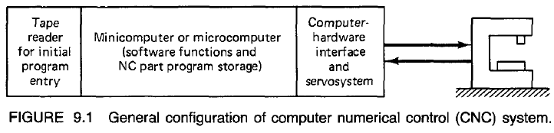
COMPUTER NUMERICAL CONTROL
Computer numerical control is an NC system that utilizes a dedicated, stored program computer to perform some or all of the basic numerical control functions.
Part programs are initially entered in a similar manner.
Punched tape readers are still the common device to input the part program into the system.
However, in conventional numerical control, the punched tape is cycled through the reader for every workpiece in the batch.
With CNC, the program is entered once and then stored in the computer memory.
Thus the tape reader is used only for the original loading of the part program and data.
Compared to regular NC, CNC offers additional flexibility and computational capability.
New system options can be incorporated into the CNC controller simply by reprogramming
Because of this reprogramming capacity, CNC is often referred to by the term "soft-wired" NC

Slide 19
Functions of CNC
There are a number of functions which CNC is designed to perform.
Several of these functions would be either impossible or very difficult to accomplish with conventional NC.
The principal functions of CNC are:
1. Machine tool control
2. In-process compensation
3. Improved programming and operating features
4. Diagnostics

Slide 20
MACHINE TOOL CONTROL
The primary function of the CNC system is control of the machine tool.
This involves conversion of the part program instructions into machine tool motions through the computer interface and servosystem
The controller consists of the soft-wired controller unit and hard-wired controller unit (logic circuits or data buffer blocks)
The capability to conveniently incorporate a variety of control features into the soft-wired controller unit is the main advantage of CNC.
Some of the control functions, such as circular interpolation, can be accomplished more efficiently with hard-wired controller unit
Two alternative controller designs in CNC:
1. Hybrid CNC
2. Straight CNC

Slide 21
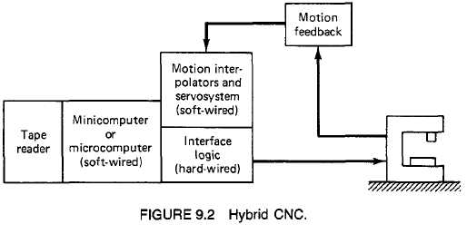
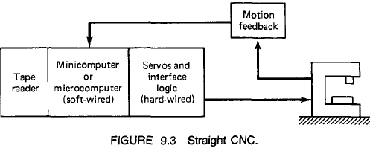
Hybrid CNC and Straight CNC
Hybrid CNC
hard-wired controller performs feed rate generation and circular interpolation.
soft-wired controller performs remaining control functions
Straight CNC
Computer (soft-wired controller) performs all the NC functions such as Interpolation, tool position feedback
hard-wired controller required to interface the computer with the machine tool and the operator's console. Interpolation, tool position feedback, and
the computer required in a straight CNC system must be more powerful than that needed for a hybrid system

Slide 22
IN-PROCESS COMPENSATION
IN-PROCESS COMPENSATION - dynamic correction of the machine tool motions for changes or errors which occur during processing.
Some of the CNC in-process compensation are:
Adjustments for errors sensed by in-process inspection
Re-computation of axis positions when an inspection probe is used to locate a datum reference on a work-part
Offset adjustments for tool radius and length
Adaptive control adjustments to speed and/or feed

Slide 23
IMPROVED PROGRAMMING AND OPERATING FEATURES and DIAGNOSTICS
IMPROVED PROGRAMMING AND OPERATING FEATURES - The flexibility of soft-wired control has permitted the introduction of many convenient programming and operating features
Editing of part programs at the machine.
Graphic display of the tool path to verify the tape.
Various types of interpolation: circular, parabolic, and cubic interpolation.
Support of both U.S. customary units and metric units (International System)
DIAGNOSTICS - NC machine tools are complex and expensive systems
The complexity increases the risk of component failures which lead to system downtime. Therefore avoid downtime as much as possible.

Slide 24
ADVANTAGES OF CNC
1. The part program tape and tape reader are used only once
2. Tape editing at the machine site
3. Metric conversion
4. Greater flexibility
5. User-written programs
6. Total manufacturing system

Slide 25
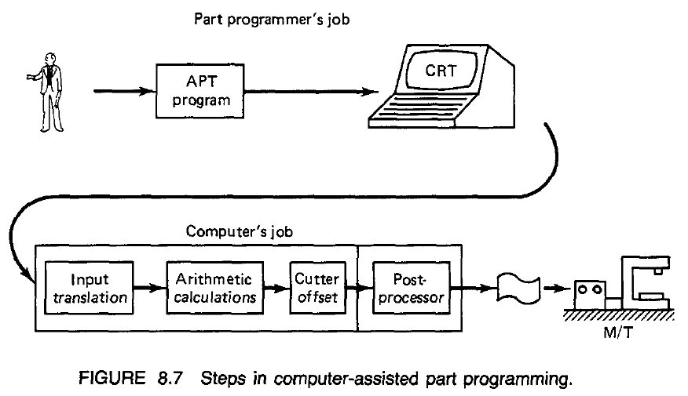
Computer-assisted Part Programming
Employ the high-speed digital computer to assist in the part programming process.
Many part-programming language systems have been developed to perform automatically most of the calculations which the programmer would otherwise be forced to do.
This saves time and results in a more accurate and more efficient part program.

Slide 26
Computer-assisted Part Programming
The part programmer's job
The part programmer's responsibility in computer-assisted part programming consists of two basic steps:
1. Defining the workpart geometry
2. Specifying the operation sequence and tool path
It is the part programmer's task to enumerate the elements out of which the part is composed.
Each geometric element must be identified and the dimensions and location of the element explicitly defined.
After defining the work-part geometry, the programmer must next construct the path that the cutter will follow to machine the part.
This tool path specification involves a detailed step-by-step sequence of cutter moves

Slide 27
Computer-assisted Part Programming
The computer's job
The computer's job in computer-assisted part programming consists of the following steps:
1. Input translation
2. Arithmetic calculations
3. Cutter offset computation
4. Postprocessor
The part programmer enters the program written in the APT or other language. The input translation component converts the coded instructions contained in the program into computer-usable form, preparatory to further processing.
The arithmetic calculations unit of the system consists of a comprehensive set of subroutines for solving the mathematics required to generate the part surface. Includes time-consuming geometry and trigonometry calculations, to concentrate on the work-part processing.

Slide 28
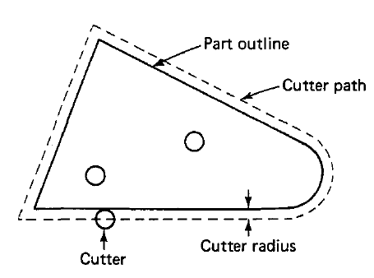
Computer-assisted Part Programming
The important task of the part programmer is that of constructing the tool path.
The actual tool path is different from the part outline because the tool path is defined as the path taken by the center of the cutter.
The purpose of the cutter offset computations is to offset the tool path from the desired part surface by the radius of the cutter. This means that the part programmer can define the exact part outline in the geometry statements.
NC machine tool systems are different. They have different features and capabilities. They use different NC tape formats.
The final task of the computer in computer-assisted part programming is to take the general instructions and make them specific to a particular machine tool system.
The unit that performs this task is called a postprocessor.

Slide 29
NC part programming languages
APT (Automatically Programmed Tools) - The product developed by of the MIT developmental work on NC programming systems in June 1956 and it was first used in production around 1959
ADAPT
EXAPT (Extended subset of APT)
UNIAPT
SPLIT (Sundstrand Processing Language Internally Translated)
COMPACT II
PROMPT
CINTURNII
Reference: Numerical Control, The Beginnings of CAM – CAD/CAM by M. P. Groover

Slide 30
The APT Language
APT language is English-like statements and to show how they are used to command the cutting tool through its sequence of machining operations.
Geometry statements - These define the geometric elements that comprise the work-part
Motion statements - These are used to describe the path taken by the cutting tool.
3. Postprocessor statements - They are used to specify feeds and speeds and to actuate other features of the machine.
4. Auxiliary statements - These are miscellaneous statements used to identify the part, tool, tolerances, and so on.

Slide 31
Geometry statements - The definition of the work-part elements
The general form of an APT geometry statement is this:
symbol = geometry type/descriptive data
PI = POINT/5.0, 4.0, 0.0
The statement is made up of three sections.
The first is the symbol used to identify the geometric element
The second section of the geometry statement identifies the type of geometry element - POINT, LINE, PLANE, and CIRCLE.
The third section of the geometry statement - May include quantitative dimensional and positional data
A slash separates the surface type from the descriptive data
Commas are used to separate the words and numbers in the descriptive data

Slide 32
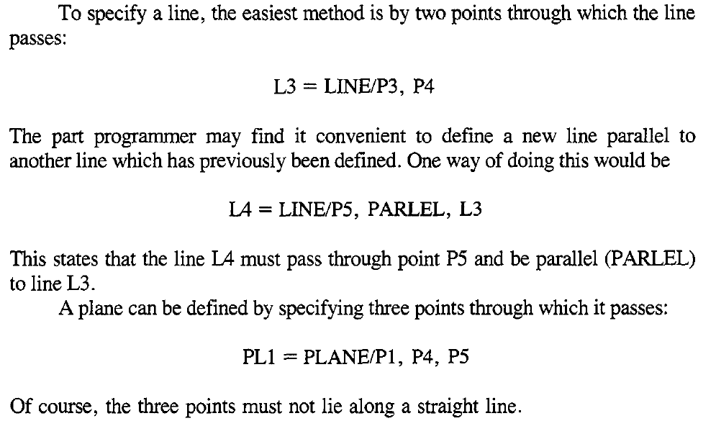
Geometry statements

Slide 33
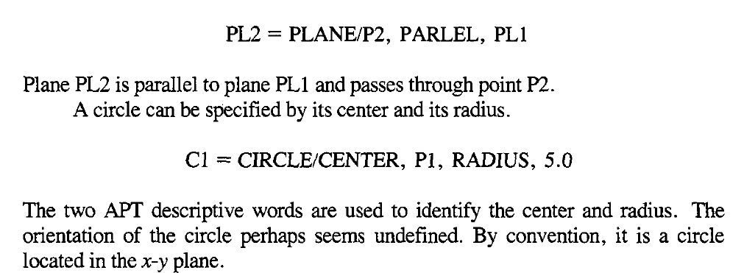
Geometry statements

Slide 34
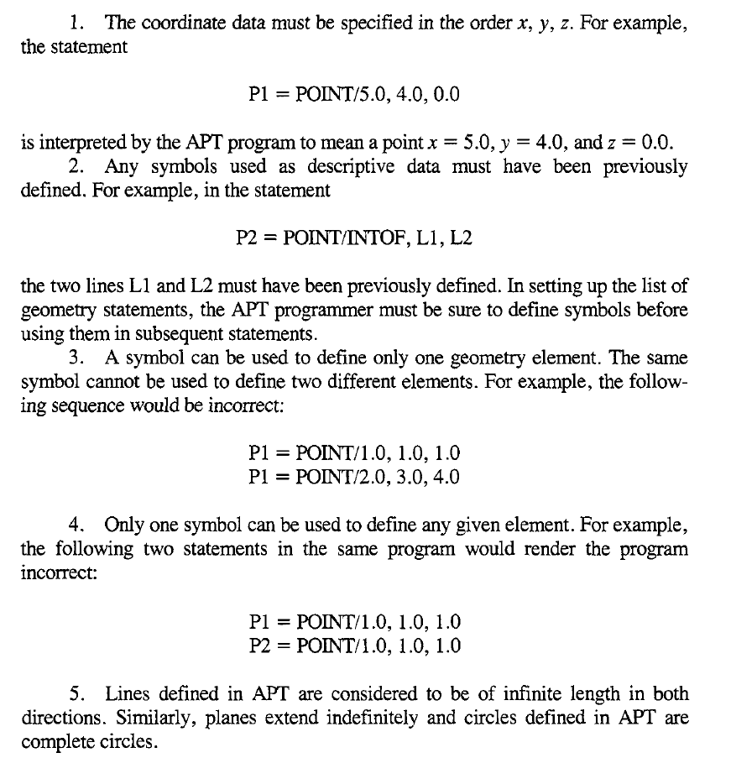
Rules that must be followed
in formulating an
APT geometry statement

Slide 35
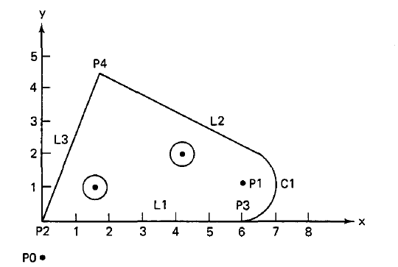
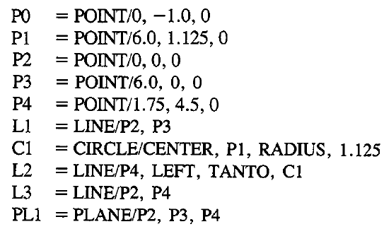
Example

Slide 36
Motion statements
The general form of a motion statement is
motion command/descriptive data
GOTO/PI
The statement consists of two sections separated by a slash.
The first section is the basic motion command, which tells the tool what to do.
The second section is comprised of descriptive data, which tell the tool where to go
At the beginning of the motion statements, the tool must be given a starting point - target point is the location where the operator has positioned the tool at the start of the job.
FROM/TARG
or
FROM/-2.0, -2.0, 0.0

Slide 37
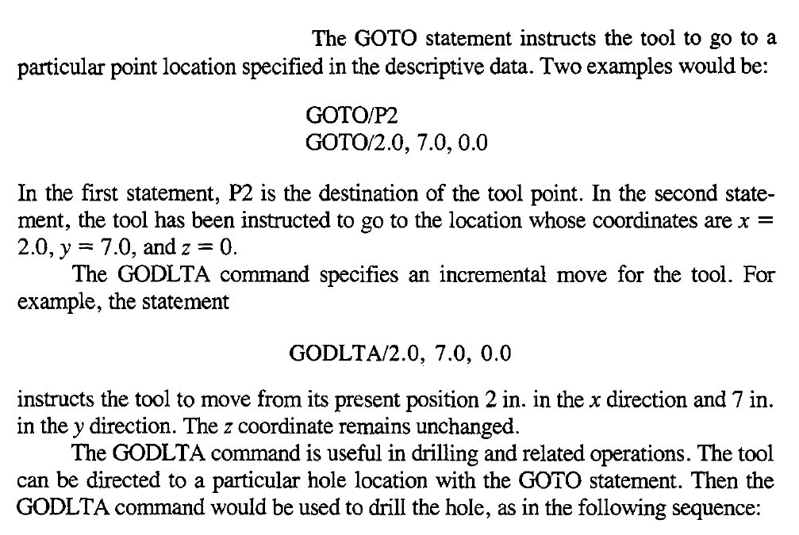
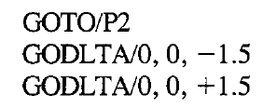
Motion statements - POINT-TO-POINT MOTIONS
Two basic PTP motion commands: GOTO and GODLTA

Slide 38
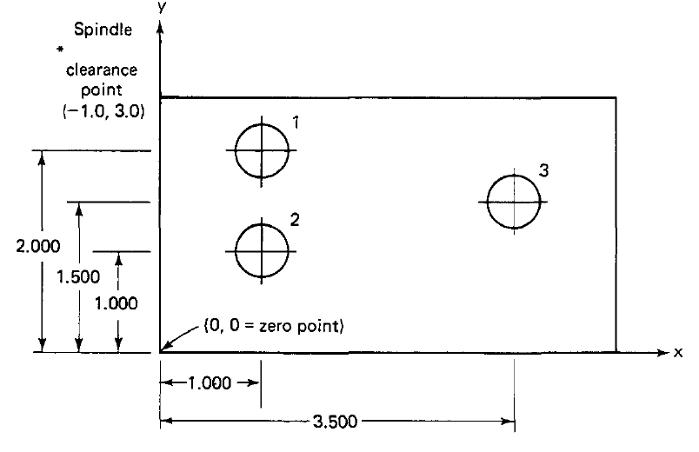
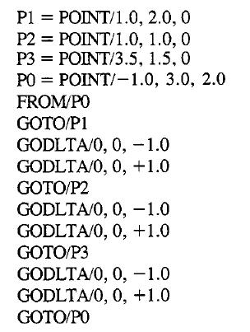
Example

Slide 39
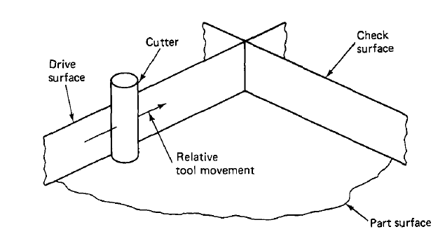
Contouring Motions
Contouring commands are somewhat more complicated because the tool's position must be continuously controlled throughout the move
This control accomplish by intersecting surfaces
1. Drive surface - The surface guides the side of the cutter
2. Part surface - This is the surface on which the bottom of the cutter rides (may or may not be an actual surface of the workpart)
3. Check surface - This is the surface that stops the movement of the tool

Slide 40
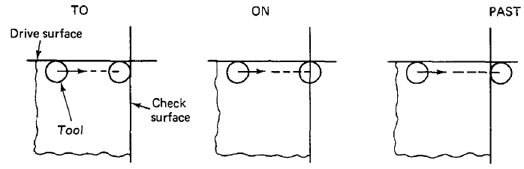
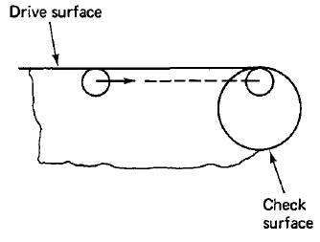
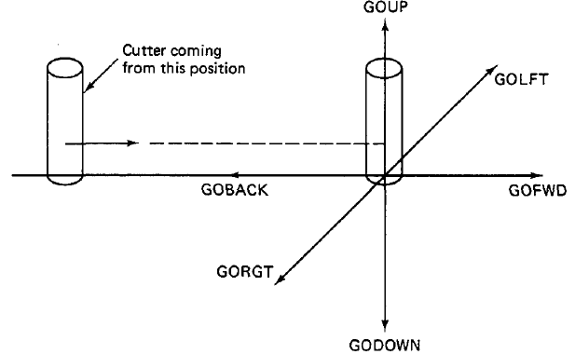

APT contour motion statement
The APT contour motion statement commands the cutter to move along the drive and part surfaces and the movement ends when the tool is at the check surface.
The three APT modifier words are TO, ON, and PAST, and TANTO (when the drive surface is tangent to a circular check surface) their use with regard to the check surface is shown in figure
TANTO moves tool to point of tangency between two surfaces, at least one of which is circular

Slide 41
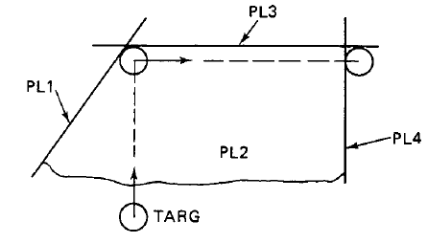
APT contour motion statement
FROM/TARG
GO/TO, PL1, TO, PL2, TO, PL3
GO command instructs the tool to move to the intersection of the drive surface (PL1), the part surface (PL2), and the check surface (PL3). The periphery of the cutter is tangent to PL1 and PL3, and the bottom of the cutter is touching PL2
GO/TO Vs GOTO command : GOTO is used only for FTP motions and GO/TO is used to initialize the sequence of contouring motions
GORGT/PL3, PAST, PL4
The tool to move along PL3 (drive surface)
The tool would continue until past surface PL4, which is the new check surface
or
GORGT/L3, PAST, L4
substituted lines L3 and L4 for planes PL3 and PL4, respectively

Slide 42
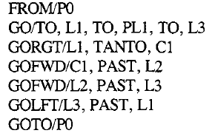
Example

Slide 43
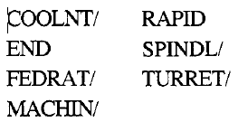
Postprocessor statements
Control the operation of the spindle, the feed, and other features of the machine tool called postprocessor statements
Note:
with or without the slash (/).The statements without the slash are self-contained

Slide 44
Auxiliary statements
CLPRNT
CUTTER
INTOL/
OUTTOL/
F1NI
CUTTER/.500
would instruct the APT program that the cutter diameter is 0.500 in

Slide 45
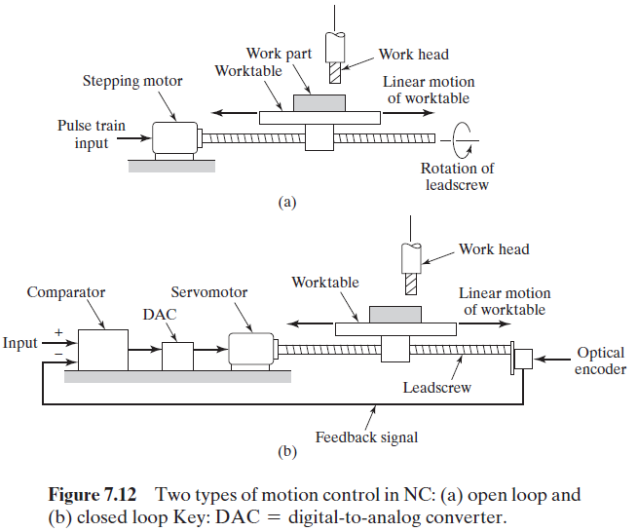
NC Positioning Systems
NC positioning system converts the coordinate axis values in the NC part program into relative positions of the tool and work part during processing.
Consider the simple positioning system –
The system consists of a cutting tool and a worktable on which a work part is fixtured.
The table is designed to move the part relative to the tool.
The worktable moves linearly by means of a rotating leadscrew,
which is driven by a stepper motor or servomotor
Two types of control systems are used in positioning systems:
(a) open loop
(b) closed loop
An open-loop system operates without verifying that the actual position achieved in the move is the same as the desired position.
A closed-loop system uses feedback measurements to confirm that the final position of the worktable is the location specified in the program.

Slide 46
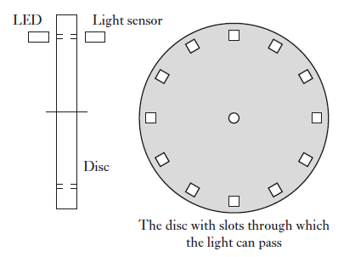
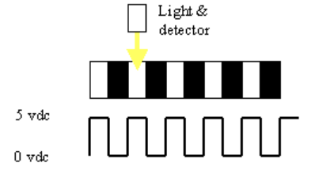
Optical encoders
An encoder is a device that provides a digital output as a result of a linear or angular displacement
Encoders can be grouped into two categories: incremental encoders and absolute encoders
Incremental encoders: detect changes in position (rotation) from some datum by generating pulses with each movement
Absolute encoders : give the actual angular position at any given moment
Incremental encoder for the measurement of angular displacement.
A beam of light passes through slots in a disc and is detected
by a suitable light sensor.
When the disc is rotated, a pulsed output is produced by the
sensor.
The number of pulses proportional
to the angle through which the disc rotates

Slide 47
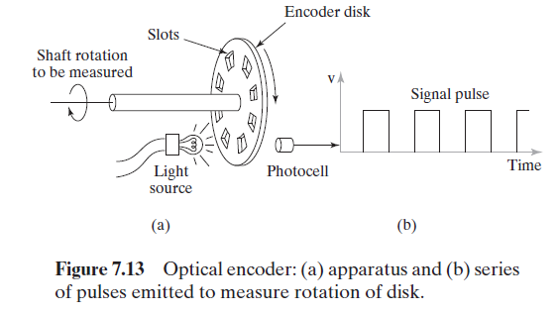
Optical encoders

Slide 48
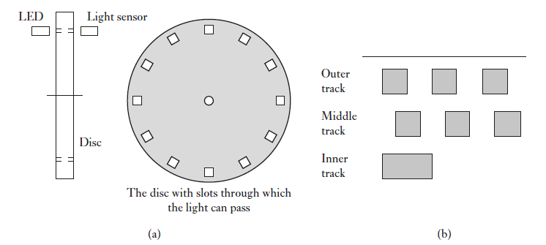
The outer and middle tracks have a series of equally spaced holes that go completely round the disc but with the holes in the middle track offset from the holes in the outer track by one-half the width of a hole.
This offset enables the direction of rotation to be determined.
In a clockwise direction the pulses in the outer track lead those in the inner
In the anti-clockwise direction they lag

Slide 49
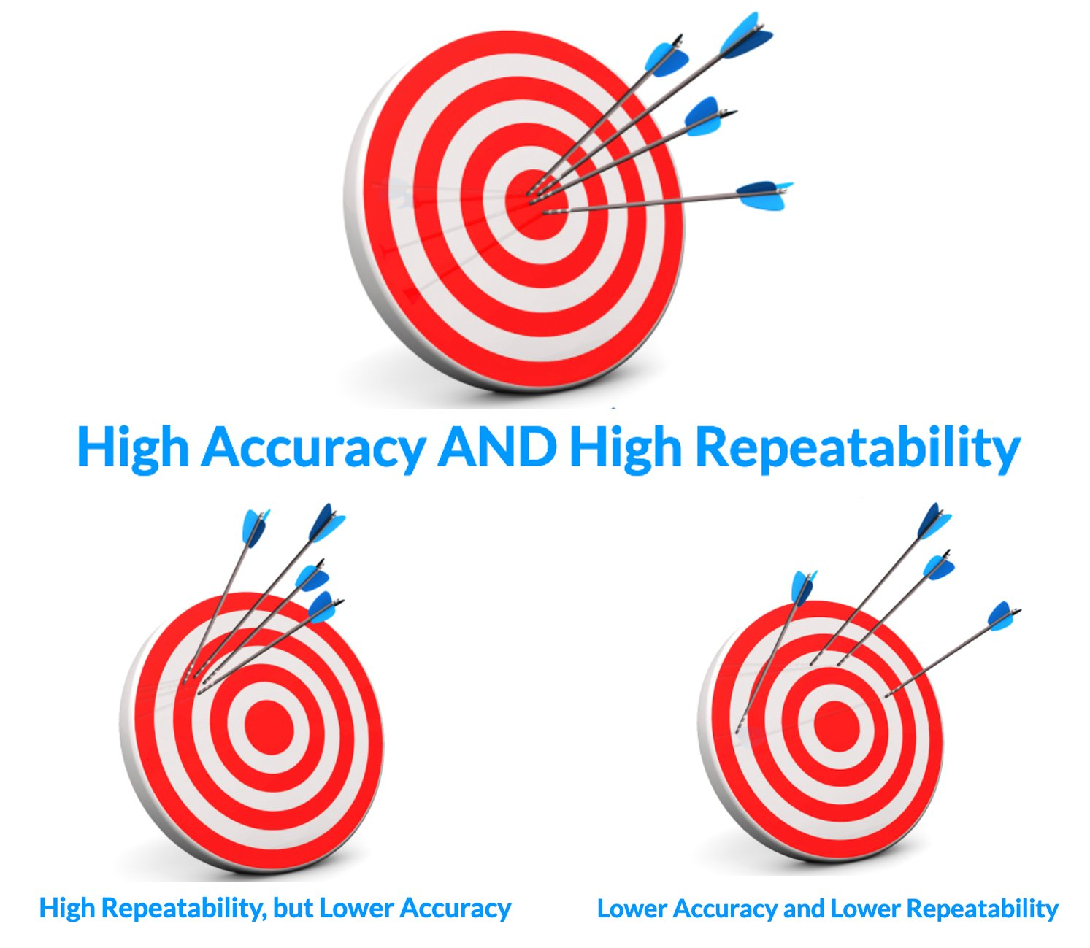
Precision in NC Positioning Systems
Control Resolution: This refers to the smallest possible movement a system can make.
Imagine a ruler with millimeter markings. The control resolution would be 1 millimeter - the system can't move any smaller than that increment.
Control resolution refers to the control system’s ability to divide the total range of the axis movement into closely spaced points that can be distinguished by the Machine Control Unit (MCU)
Accuracy: This describes how close the system's actual position is to the commanded position. Ideally, the system should move exactly where it's instructed to. Accuracy considers any errors or deviations from the target.
Repeatability: This defines how consistently the system returns to the same position when repeatedly commanded to a specific location. It's about precision in achieving the same target point over and over.

Slide 50
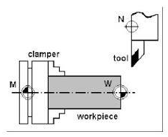
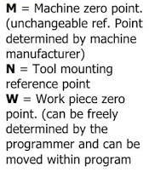
CNC machining - zero positions
Machine Zero:
This is a fixed reference point established by the manufacturer
It's typically located at the farthest positive travel limits of the X, Y, and Z axes on the machine.
This point is permanent and cannot be changed by the operator.
Workpiece Zero (or Program Zero):
This is a user-defined reference point that corresponds to a specific location on the workpiece itself.
This is the point you establish before running a CNC program to tell the machine where the part is located within the machine's overall coordinate system.
Zero Offset (Work Offset)
This is the difference between the machine zero and the workpiece zero.
It essentially tells the CNC controller how much the programmed toolpath needs to be shifted relative to the machine's home position to machine the part according to the program.

Slide 51
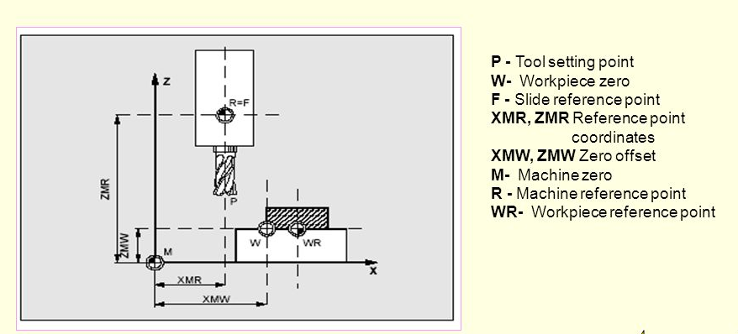
CNC machining : Zero Offset
Machine zero and work piece zero need not be identical.
Depending on the type of work piece and the way it is clamped, the distance between the machine zero and work piece zero can vary
In part program processing this is compensated by the zero offset

Slide 52
errors affects the accuracy of NC machine tools
Static errors
Mechanical imperfections in the machine tool, such as misalignment of ways, wear on bearings, and backlash in gears.
Thermal expansion of the machine tool due to changes in temperature.
Tool wear and deflection.
Static errors can be minimized through proper calibration and maintenance of the machine tool, as well as by using tool wear compensation techniques.

Slide 53
errors affects the accuracy of NC machine tools
Dynamic errors are errors that are caused by the motion of the machine tool. They are typically more significant at higher speeds and accelerations.
Dynamic errors can be caused by factors such:
The inertia of the machine tool components, which can cause the machine to lag behind the programmed toolpath.
The compliance of the machine tool structure, which can cause the machine to deform under load.
The control system dynamics, which can introduce delays and inaccuracies into the movement of the machine.
Dynamic errors can be minimized through careful design of the machine tool structure and control system, as well as by using feedforward control techniques.
By understanding and minimizing both static and dynamic errors, manufacturers can ensure that their NC machine tools produce parts with high accuracy and precision

Slide 54
Basic Length Unit (BLU)
It represents the smallest increment of movement that a CNC machine tool can make in a given direction. In simpler terms, it's the minimum distance a CNC machine can move at one time.
BLU = Lead screw pitch / Steps per motor revolution
Lead screw pitch: This is the distance the nut on the lead screw travels along the screw for each complete revolution
Steps per motor revolution: This is the number of discrete angular movements a stepper motor can make in one complete revolution
In NC machine, the displacement length per one pulse output from machine is defined as a Basic Length Unit (BLU).
CNC computer each bit (binary digit) represents 1 BLU.
Bit = BLU
If one pulse makes a servo motor rotate by one degree and the servo motor moves the table by 0.0001 mm, one BLU will be 0.0001 mm.

